Slide 1

Social Science Research Design and Statistics, 2/e Alfred P. Rovai, Jason D. Baker, and Michael K. Ponton
Recoding Variables
PowerPoint Prepared by Alfred P. Rovai
IBM® SPSS® Screen Prints Courtesy of International Business Machines Corporation,
© International Business Machines Corporation.

Slide 2
Recoding Variables
Recode into Same Variables allows one to reassign the values of existing variables or collapse ranges of existing values into new values by changing an existing variable. For example, one can collapse scale data into low, medium, and high categories.
Recode into Different Variables allows one to reassign the values of existing variables or collapse ranges of existing values into new values for a new variable.
Automatic Recode allows one to convert values into consecutive integers.

Slide 3
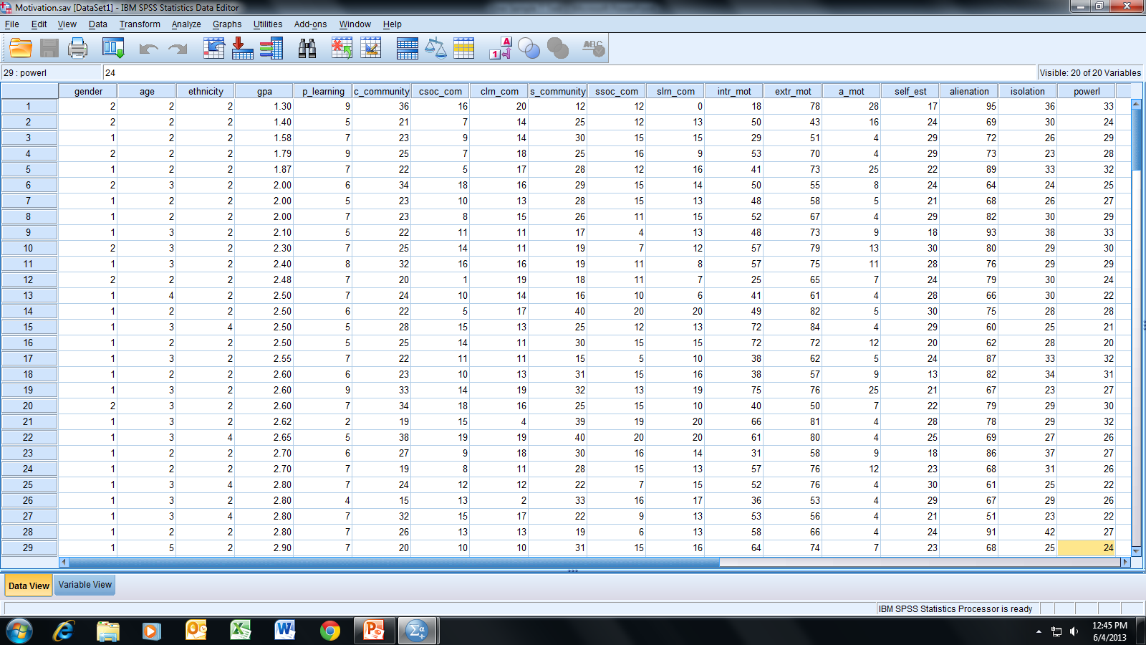
Open the dataset Motivation.sav.
File available at http://www.watertreepress.com/stats
TASK
Recode gpa into a different variable by collapsing
existing data using the following ranges:
3.67 to 4.00 = A
2.67 to 3.66 = B
2.00 to 2.66 = C
Below 2.00 = F

Slide 4
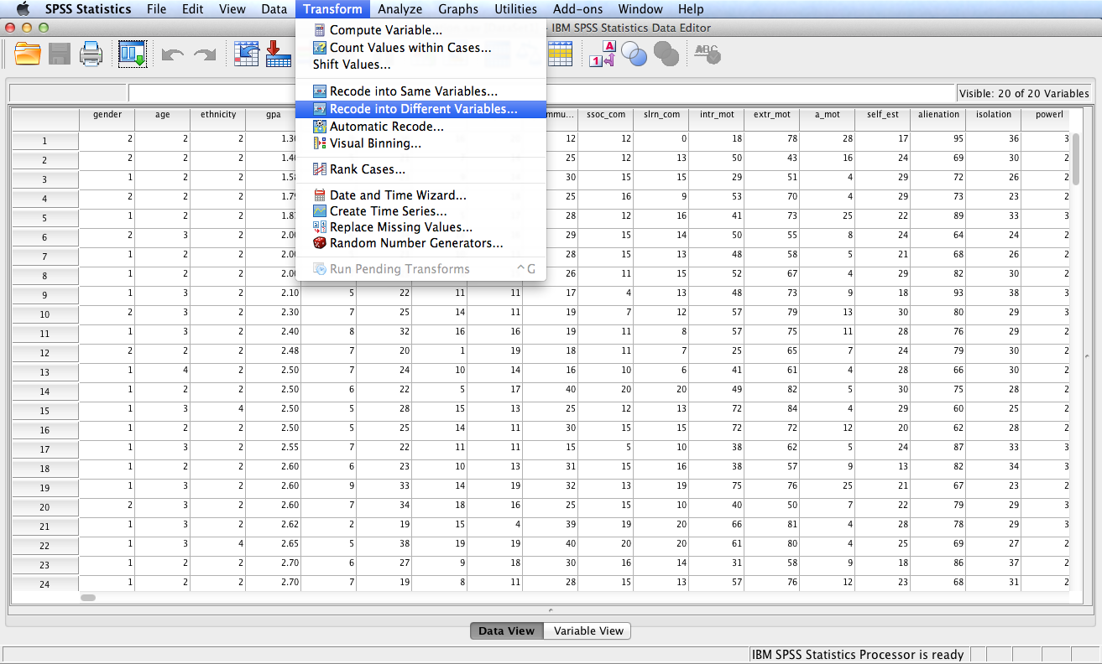
Follow the menu as indicated.

Slide 5
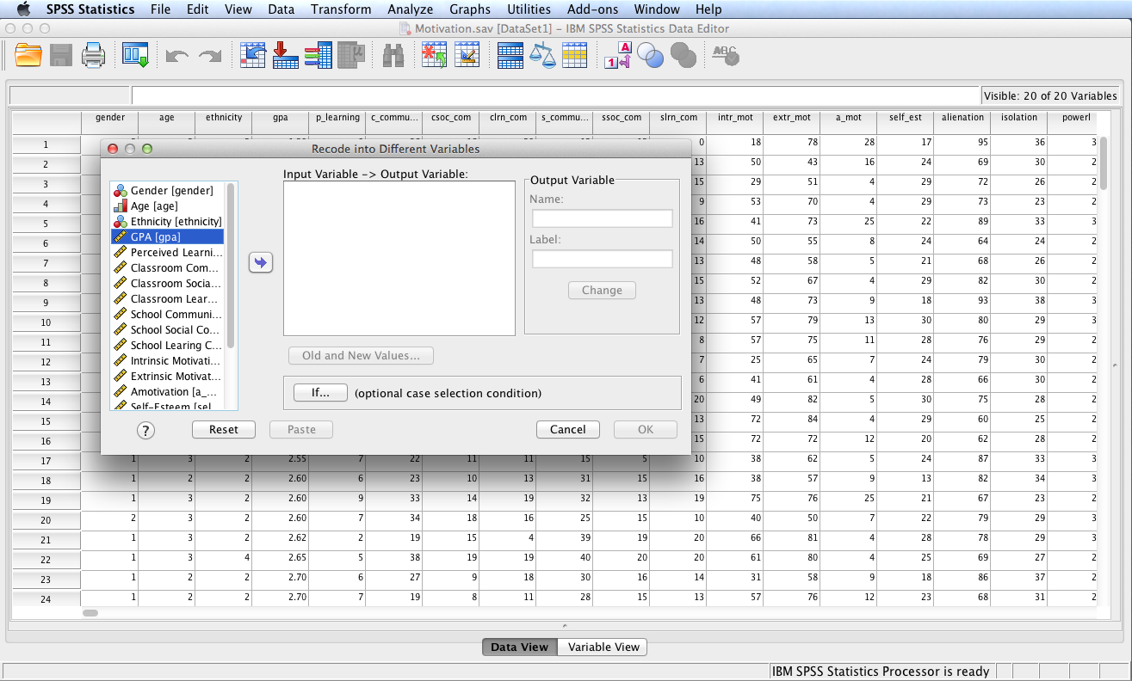
In this example, GPA (gpa) is the input variable. Start by highlighting
GPA(gpa) and then clicking the right arrow icon to move the variable
to the Input Variable - > Output Variable: box.

Slide 6
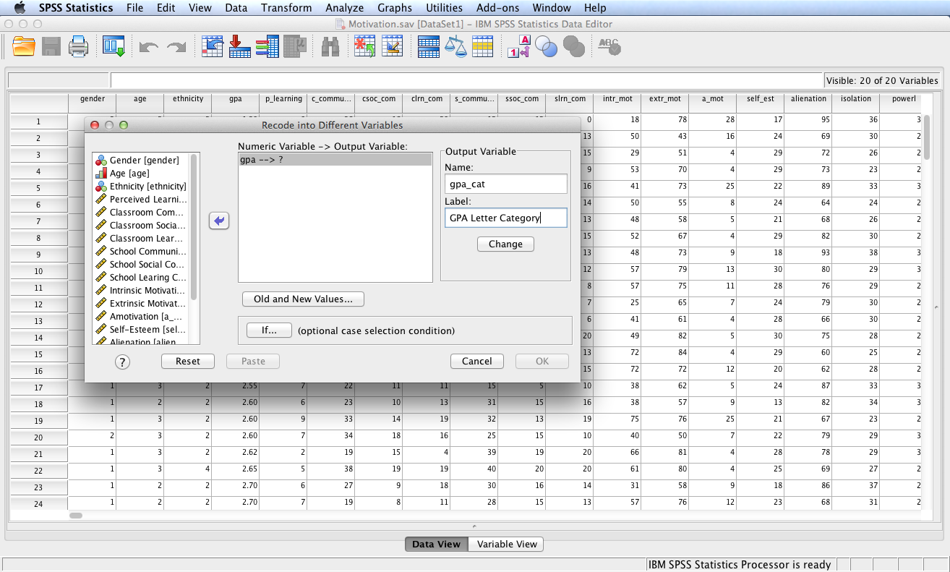
Next enter a Name and Label for the Output Variable. Then click the Change icon.

Slide 7
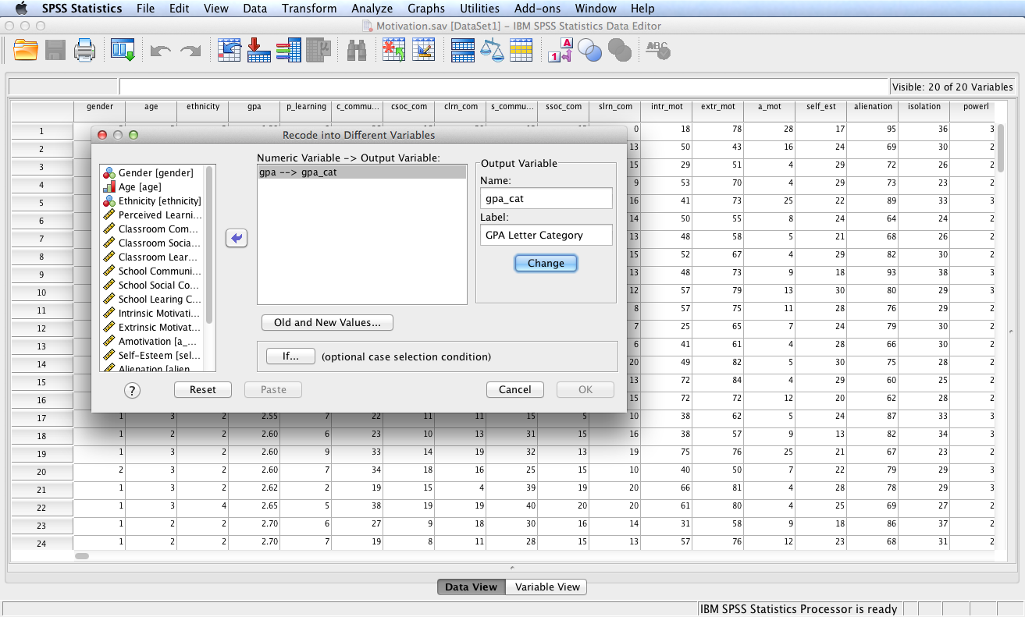
Next, click the Old and New Values… icon.

Slide 8
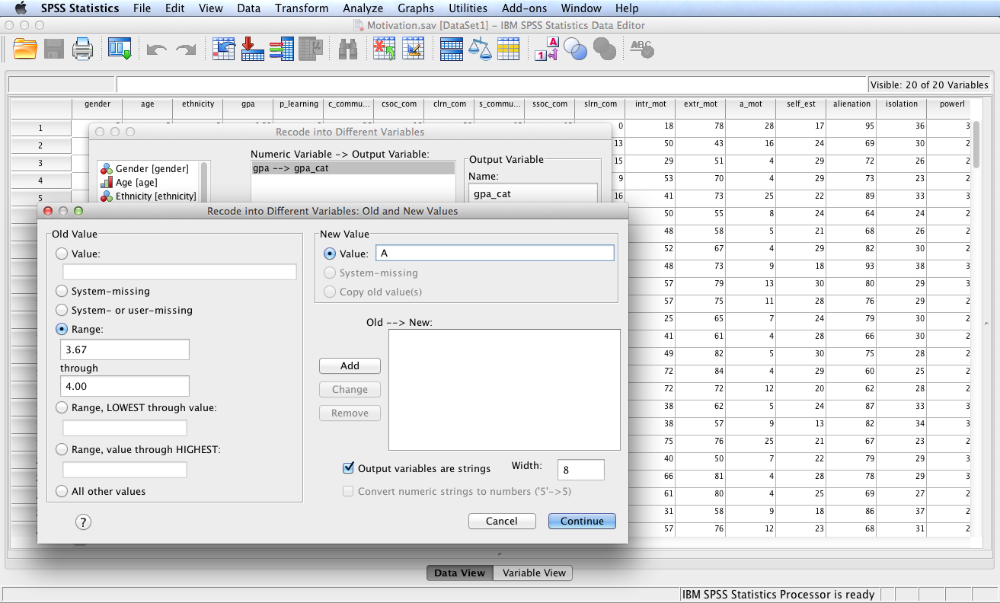
Next, click on the Range radio
button, enter the range for the first
category, select Output variables are
Strings, then enter the Value for
the first category. Click Add.
Repeat this process for the next
two categories. For the final category,
use the Range, Lowest through value
radio button.

Slide 9
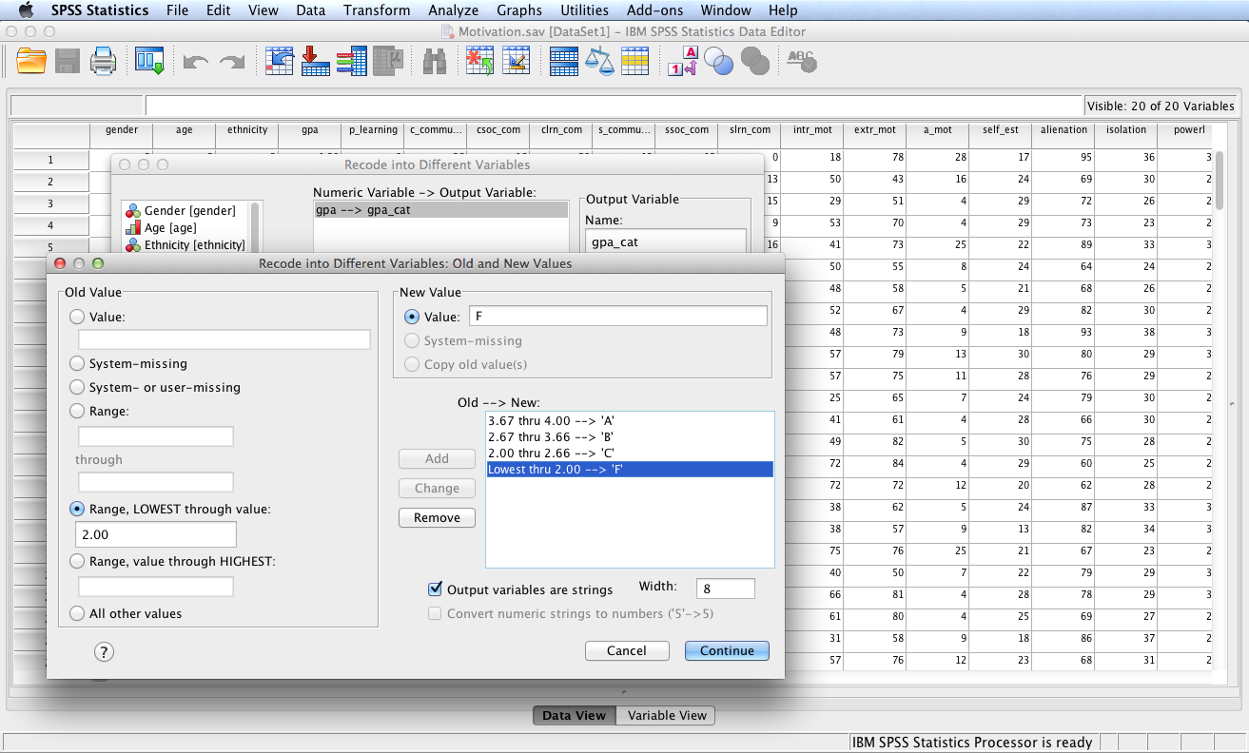
After entering all categories
click the Continue button then the OK button.

Slide 10
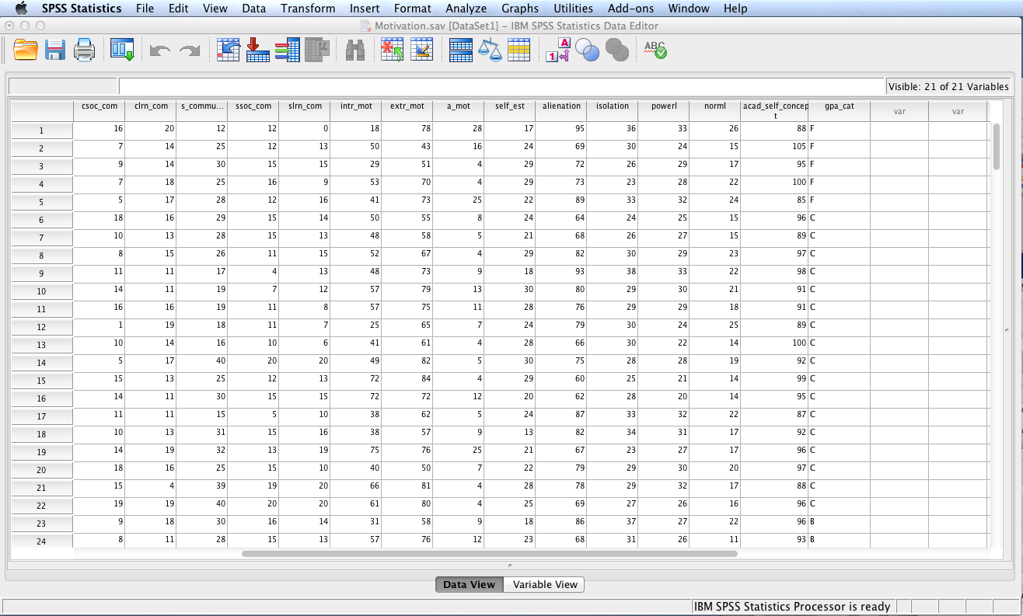
The result will be addition of a new string variable named gpa_cat.
If numeric instead of string output is desired one can specify
numerical output values as numbers, e.g., 1, 2, 3, and 4. One can then
go to Variable View and use the Values field to identify value labels,
i.e., 1 = A, 2 = B, 3 = C, and 4 = F.

Slide 11
End of Presentation

